Slide 1
Introduction to Java for C++ Programmers
Segment 2 – Swing Basics
Professor: Mahboob Ali

Slide 2
Swing
Java Swing is a part of Java Foundation Classes (JFC) that is used to create window-based applications.
Built on the top of AWT API and entirely written in java.
Provides platform-independent and lightweight components.
The javax.swing package provides classes for java swing API such as JButton, JTextField, JTextArea, JRadioButton, JCheckbox, JMenu, JColorChooser etc.

Slide 3
AWT
Swing
AWT components are platform-dependent.
AWT components are heavyweight.
AWT doesn't support pluggable look and feel.
AWT provides less components than Swing.
AWT doesn't follows MVC(Model View Controller)
Java swing components are platform-independent.
Swing components are lightweight.
Swing supports pluggable look and feel.
Swing provides more powerful components such as tables, lists, scrollpanes, colorchooser, tabbedpane etc.
Swing follows MVC.

Slide 4

GUI terminology
window: A first-class citizen of the graphical desktop.
  Also called a top-level container.
  examples: frame, dialog box, applet
component: A GUI widget that resides in a window.
  Also called controls in many other languages.
  examples: button, text box, label
container: A logical grouping for storing components.
  examples: panel, box

Slide 5
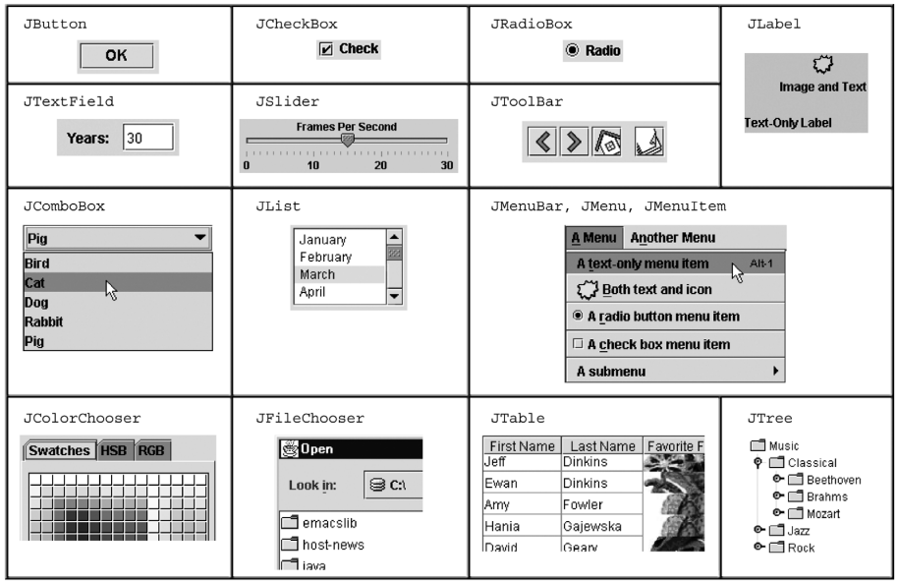
Components

Slide 6
JFC is short for Java Foundation Classes, which encompass a group of features for building graphical user interfaces (GUIs) and adding rich graphics functionality and interactivity to Java applications.
Swing consist of 18 public packages with 737 classes.
Swing supports mouse-less operation, i.e., it can operate entirely using keyboard.
Swing components support "tool-tips".

Slide 7
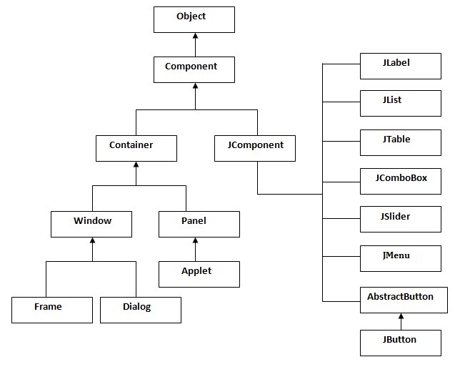
Hierarchy of Swing

Slide 8
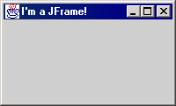
JFrame
a graphical window to hold other components
public JFrame()
public JFrame(String title)
Creates a frame with an optional title.
  Call setVisible(true) to make a frame appear on the screen after creating it.
public void add(Component comp)
Places the given component or container inside the frame.

Slide 9
More JFrame
public void setDefaultCloseOperation(int op)
Makes the frame perform the given action when it closes.
  Common value passed: JFrame.EXIT_ON_CLOSE
  If not set, the program will never exit even if the frame is closed.
public void setSize(int width, int height)
Gives the frame a fixed size in pixels.
public void pack()
Resizes the frame to fit the components inside it snugly.

Slide 10
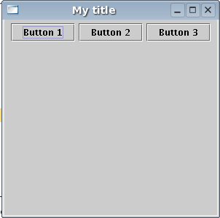
JButton
a clickable region for causing actions to occur
public JButton(String text)
Creates a new button with the given string as its text.
public String getText()
Returns the text showing on the button.
public void setText(String text)
Sets button's text to be the given string.

Slide 11
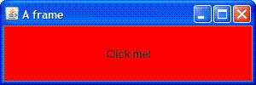
GUI example
import java.awt.*; // Where is the other button?
import javax.swing.*;
public class GuiExample1 {
public static void main(String[] args) {
JFrame frame = new JFrame();
frame.setDefaultCloseOperation(JFrame.EXIT_ON_CLOSE);
frame.setSize(new Dimension(300, 100));
frame.setTitle("A frame");
JButton button1 = new JButton();
button1.setText("I'm a button.");
button1.setBackground(Color.BLUE);
frame.add(button1);
JButton button2 = new JButton();
button2.setText("Click me!");
button2.setBackground(Color.RED);
frame.add(button2);
frame.setVisible(true);
}
}

Slide 12
Sizing and positioning
How does the programmer specify where each component appears, how big each component should be, and what the component should do if the window is resized / moved / maximized / etc.?
Absolute positioning (C++, C#, others):
Programmer specifies exact pixel coordinates of every component.
  "Put this button at (x=15, y=75) and make it 70x31 px in size."
Layout managers (Java):
Objects that decide where to position each component based on some general rules or criteria.
  "Put these four buttons into a 2x2 grid and put these text boxes in a horizontal flow in the south part of the frame."

Slide 13
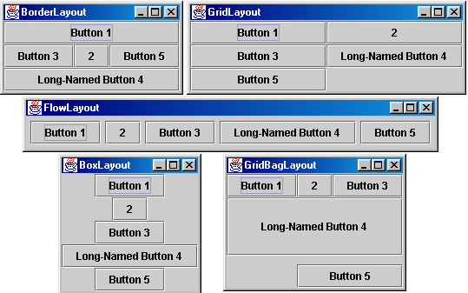
Containers and layout
Place components in a container; add the container to a frame.
  container: An object that stores components and governs their positions, sizes, and resizing behavior.

Slide 14
JFrame as container
A JFrame is a container. Containers have these methods:
public void add(Component comp)
public void add(Component comp, Object info)
Adds a component to the container, possibly giving extra information about where to place it.
public void remove(Component comp)
public void setLayout(LayoutManager mgr)
Uses the given layout manager to position components.
public void validate()
Refreshes the layout (if it changes after the container is onscreen).

Slide 15
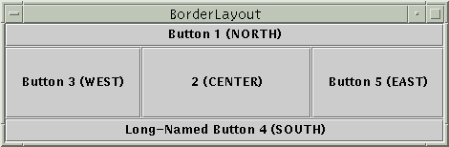

Preferred sizes
Swing component objects each have a certain size they would "like" to be: Just large enough to fit their contents (text, icons, etc.).
  This is called the preferred size of the component.
  Some types of layout managers (e.g. FlowLayout) choose to size the components inside them to the preferred size.
  Others (e.g. BorderLayout, GridLayout) disregard the preferred size and use some other scheme to size the components.
Buttons at preferred size: Not preferred size:

Slide 16
Swing By Inheritance
import javax.swing.*;
public class ExampleWithInherit extends JFrame{
//inheriting JFrame
JFrame f;
ExampleWithInherit(){
JButton b=new JButton("click");//create button
b.setBounds(130,100,100, 40);
add(b);//adding button on frame
setSize(400,500);
setLayout(null);
setVisible(true);
}
public static void main(String[] args) {
new ExampleWithInherit();
}}

Slide 17
Swing By Association
import javax.swing.*;
public class ByAssociation {
JFrame f;
ByAssociation(){
f=new JFrame();//creating instance of JFrame
//creating instance of JButton
JButton b=new JButton("click");
b.setBounds(130,100,100, 40);
f.add(b);//adding button in JFrame
f.setSize(400,500);//400 width and 500 height
f.setLayout(null);//using no layout managers
f.setVisible(true);//making the frame visible
}
public static void main(String[] args) {
new ByAssociation();
}
}

Slide 18
JButton with ActionListener
import java.awt.event.*;
import javax.swing.*;
public class ButtonExample {
public static void main(String[] args) {
JFrame f = new JFrame("Button Example");
final JTextField tf = new JTextField();
tf.setBounds(50,50, 150,20);
JButton b = new JButton("Click Here");
b.setBounds(50,100,95,30);
b.addActionListener(new ActionListener(){
public void actionPerformed(ActionEvent e){
tf.setText("Welcome to Java Swing.");
}
});
f.add(b);f.add(tf);
f.setSize(400,400);
f.setLayout(null);
f.setVisible(true);
}
}

Slide 19
Creating Executable Java file: Jar file
The jar (Java Archive) tool of JDK provides the facility to create the executable jar file. An executable jar file calls the main method of the class if you double click it.
Step – 1: Write your program regularly, take previous slide example for “Jbutton with ActionListener”
Step – 2: create your class file(s) with normal java command like, javac ButtonExample.java
Step – 3: create a filename.txt file, this text file will contain only two line,
Main-Class: ButtonExample
Line one
Line two is empty line

Slide 20

Step – 4: create jar file by adding class(es) files with your filename.txt file.
  ButtonExample.java
  ButtonExample.class
  ButtonExample$1.class
  filename.txt
  Then issue the following command to create the jar file.
  jar –cvfm ButtonExample.jar filename.txt *.class

Slide 21
Jar tool commands
The jar tool provides many switches, some of them are as follows:
  -c creates new archive file
  -v generates verbose output. It displays the included or extracted resource on the standard output.
  -m includes manifest information.
  -f specifies the archive file name
  -x extracts files from the archive file

